Slide 1
Used Cars Price Analysis
Presented by:
Jay Kumar

Slide 2
Project Objective:-
The objective of the "Used Cars Price Analysis" project is to perform a comprehensive examination of the factors influencing the pricing of used cars in the market.
By analyzing various features such as car model, mileage, age, and brand, this project aims to identify key trends, consumer preferences, and factors that significantly affect the resale value. The insights are intended to aid buyers and sellers in making informed decisions and optimizing pricing strategies.
The data was sourced from car24 platforms using Python-based web scraping techniques to extract detailed datasets for analysis.

Slide 3
Main Agenda
Web Scraping to collect the data
Data Cleaning and Manipulation
Visualization and Analysis of various factors like Mileage, Brand, Age, and Price to address key market trends and consumer preferences.
An in-depth exploration of web scraping and data visualization using Python, focusing on retrieving data on used cars across various regions. This project highlights the power of extracting, analyzing, and visualizing data to provide actionable insights into the used car market.

Slide 4
Tools Used :-
Software Requirement:-
1)Python( Jupyter notebook)
2)Power bi
3)Excel
Main Software Libraries:-
1)Pandas
2)Numpy
3)Beautiful Soups
4)Requests
5)CSV

Slide 5
INTRODUCTION :-
Overview of project:-
This project focuses on analyzing used car data through web scraping, data cleaning, modeling, and preprocessing using Python, followed by data visualization in Power BI.
Importance of Analyzing Used Car Data :-
Understanding used car data is critical to identifying market trends, analyzing price structures, consumer preferences, and the impact of different car features on pricing.
Importance of web scraping and data preprocessing and data visualization:-
Visualization tools like Power BI make complex datasets easier to understand and communicate, enabling data-driven decision-making.

Slide 6
WEB SCRAPING :-
Step 1:- IMPORT LIBRARIES
import csv # CSV file handling
import requests # HTTP requests :-web scraping or interacting with web
import pandas as pd # Data manipulation using pandas.
from bs4 import Beautiful Soup # HTML parsing using Beautifulsoup :-pulling data out of HTML and XML files and searching and modifying phrase tree

Slide 7
.
Step 2:- URL
Web url="https://www.cars24.com/buy-used-cars-
patna/?sort=bestmatch&serveWarrantyCount=true&storeCityId=8184"
Step 3:- CHECKING THE ACCESS OF URL
# Define headers to mimic a web browser
headers = {
"User-Agent": "Mozilla/5.0 (Windows NT 10.0; Win64; x64)
AppleWebKit/537.36 (KHTML, like Gecko) Chrome/96.0.4664.110
  Safari/537.36",
"Referer": "https://www.cars24.com/buy-used-cars
  -patna/?sort=bestmatch&serveWarrantyCount=true&storeCityId=8184"
}
try:
# Send a GET request with the defined headers
response = requests.get(url, headers=headers)

Slide 8
.
# Check if the request was successful (status code 200)
if response.status_code == 200:
print("Access Granted. Status Code:", response.status_code)
# If you need to do something with the webpage content, you can access it using response.text
# print(response.text) # Uncomment this line to see the webpage content
else:
print("Unexpected Status Code:", response.status_code)
except requests.exceptions.RequestException as e:
print("Error:", e)

Slide 9
.
Step 4:- Requests and beautiful soup
r=requests.get("https://www.cars24.com/buy-used-cars
-patna/?sort=bestmatch&serveWarrantyCount=true&storeCityId=8184")
soup=BeautifulSoup(r.content,'html.parser')
soup
Step 5:- column names and extracting data through classes
brand=soup.find_all('h3',class_='_2Out2')
fuel_type = soup.find_all('ul',class_='_3jRcd')
price = soup.find_all('strong',class_='_37WXy')
city = soup.find_all('p',class_='_2rxhF')
emi = soup.find_all('span',class_='_1t1AA')
Step 6:- Take empty lists
mb=[]
mf=[]
mp=[]
mc=[]
me=[]

Slide 10
.
Step 7:- Append them in for loop
for name,fuel,pri,cty,emis in zip(brand,fuel_type,price,city,emi):
mb.append(name.text)
mf.append(fuel.text)
mp.append(pri.text)
mc.append(cty.text)
me.append(emis.text)
Step 8:- converting them into Dictionary
info={'brandName':mb,'fuel_type':mf,'cost':mp,'location':mc,'emi':me}
info

Slide 11
.
Step 9:- dictionary to data frames
#converting dictionary into a data frames
#creating csv file
model=pd.DataFrame(data=info)
model.to_csv('used_cars_data info_patna_12.csv’)
model

Slide 12
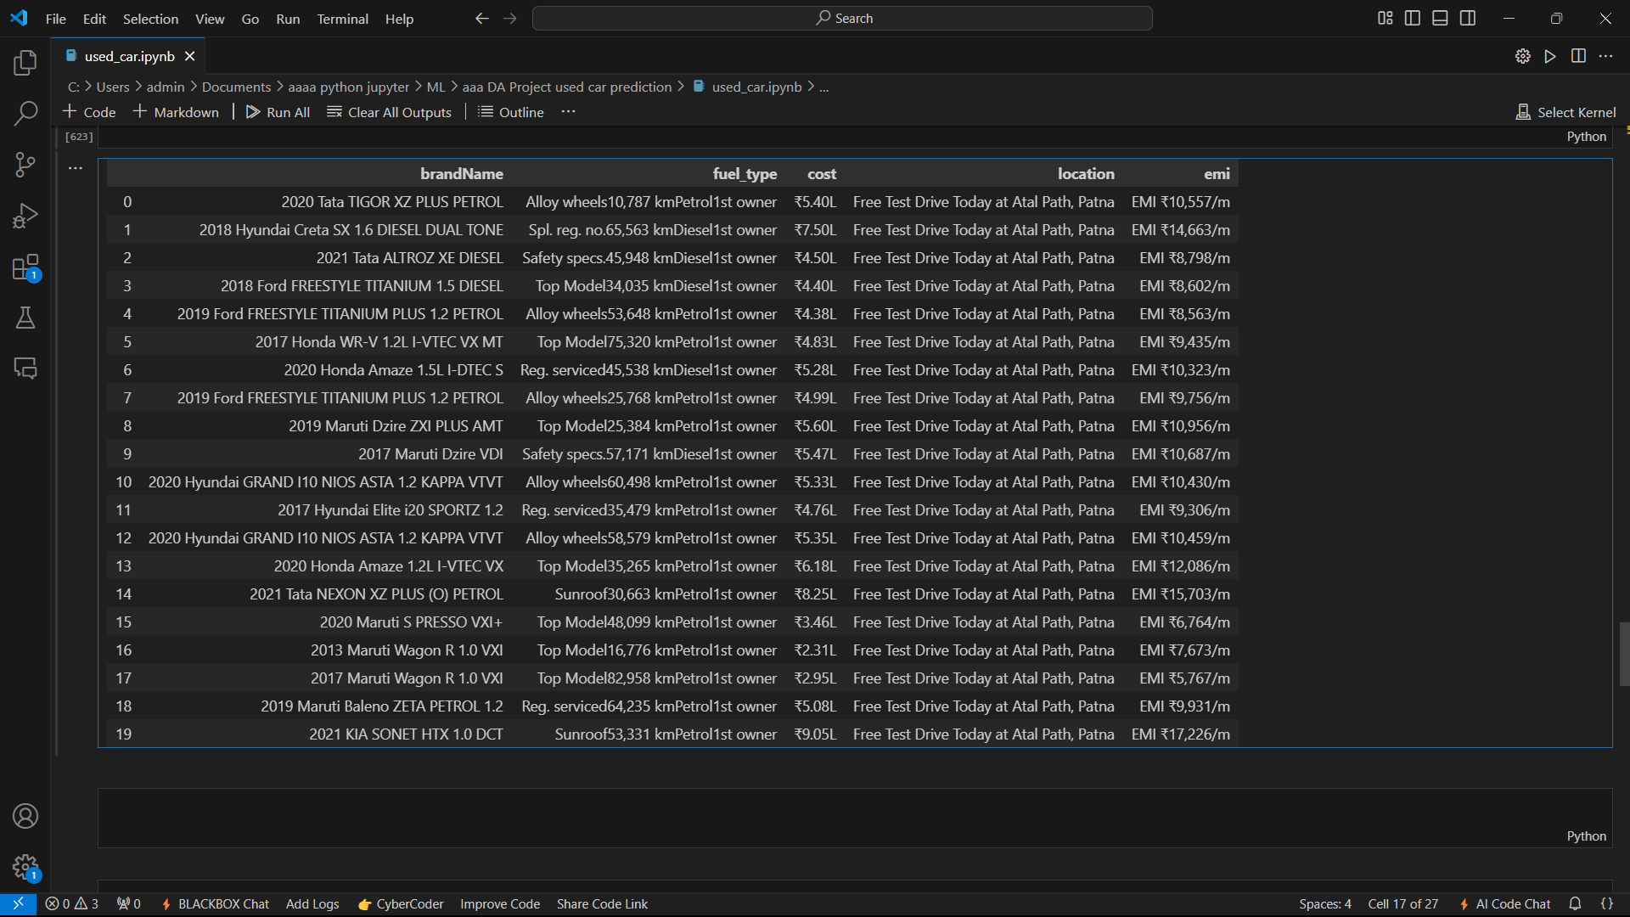
OUTPUT :-

Slide 13
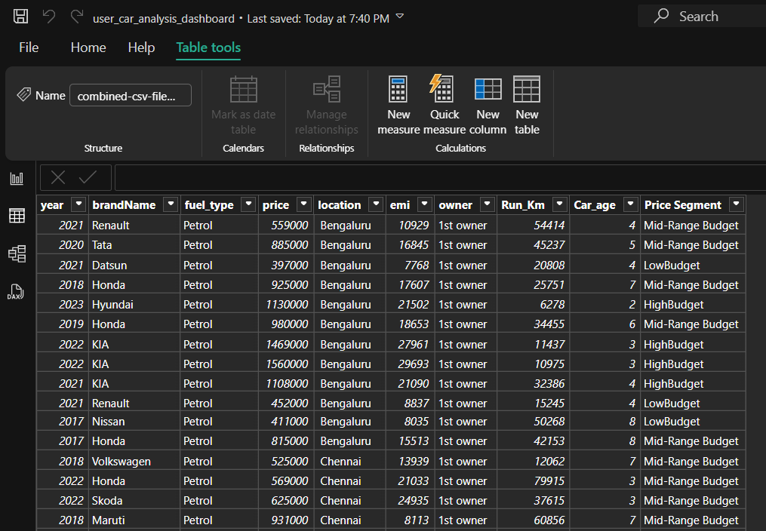
DATA MANIPULATION :-
Data manipulation is the process of changing or adjusting data to make it more organized and easier to read.
First, we need to load the data into Power BI.
After that, we need to go to Table view and add new columns as per need, for eg. Price Segment.
In that column, we will give car budget range.

Slide 14
.
Preprocessing:-
1.Import Data:
Load Data: Import datasets related to used cars from sources like Excel, CSV files, or SQL databases into Power BI.
Data Preview: Review the dataset in Power BI to understand its structure, including columns such as car name, mileage, price, and brand.
2. Data Cleaning
Remove Duplicates: Eliminate any duplicate entries to ensure the dataset's integrity.
Handle Missing Values:
Remove Rows: If null values are minimal, consider excluding rows with missing data.
Replace Values: Fill missing fields using mean, median, or default values to maintain consistency.
Correct Errors: Rectify incorrect data entries or typos to enhance accuracy.

Slide 15
.
3. Data Transformation:
Change Data Types: Update data types where necessary (e.g., ensuring numerical values for mileage or prices).
Rename Columns: Assign meaningful column names to improve readability and align with the analysis objectives.
4.Data Visualization:
Leverage Power BI's features to create visualizations such as bar charts, scatter plots, and line graphs to analyze trends, price distributions, and mileage impact on used car prices.
Customize dashboards for an intuitive understanding of insights.

Slide 16
.
4. Filtering and Sorting
Filter Rows:
Use Power BI’s filter options to eliminate unnecessary data, such as cars outside specific price ranges or brands.
Sort Data:
Organize data by columns, such as ranking cars based on prices or arranging them by mileage, to make the dataset more insightful and structured.
5. Save and Load Data
Save and Publish:
After completing data transformations, save the Power BI workbook and publish it to Power BI Service for sharing and further analysis.

Slide 17
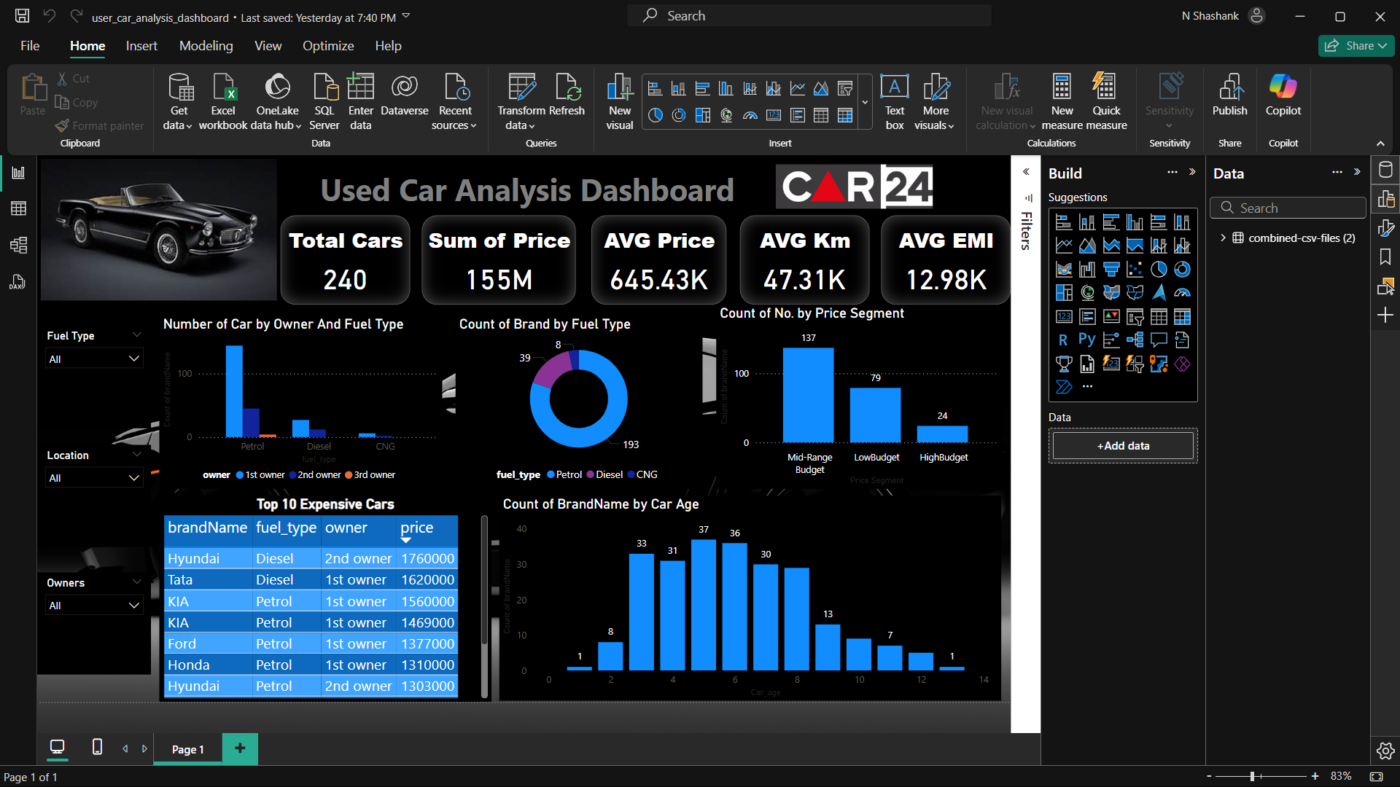
.

Slide 18
Thank You

